Slide 1

House Price Prediction
INT 404 Project

Slide 2
TEAM Members
12112787 – RISHABH TAK - 03
12113839 – AMAN KUMAR – 27
12100799 – SHUHBAM MAITY - 51

Slide 3

INTRODUCTION
► Problems faced during buying a house:
Buying a house is a stressful thing.
Buyers are generally not aware of factors that influence the house prices.
Many problems are faced during buying a house.
Hence real estate agents are trusted with the communication between buyers and sellers as well as laying down a legal contract for the transfer. This just creates a middle man and increases the cost of houses.

Slide 4

PROJECT SUMMARY
Our project is a machine learning app, based on certain specifications of your future home it will try to guess the most accurate price.
Information such as region, rooms, area are used to predict.

Slide 5

More about topic
House price prediction is the use of statistical and machine learning techniques to predict the future prices of residential properties based on various factors such as location, property size, amenities, economic trends, and demographic factors. Its applications include aiding buyers, sellers, investors, and policymakers in making informed decisions about real estate transactions. However, there are also challenges and limitations, such as data quality and model accuracy, that require continuous research and development.

Slide 6
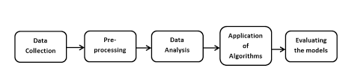
Methodology
The methodology for house price prediction involves collecting relevant data, cleaning and preprocessing the data, selecting a suitable machine learning algorithm, training and evaluating the model, and deploying it to generate predictions on new data. This process helps in making informed decisions about real estate transactions by predicting future prices based on property characteristics, location, local amenities, economic trends, and demographic factors.

Slide 7
HOW IT WORKS?
COLLECTING DATA: FIRST STEP WAS TO COLLECT DATA WE COLLECTED DATA FROM DIFFERENT SOURCES & MERGED THEM TOGETHER TO FORM OUR TRAINING DATA SET.
THEN WE TRAINED THE MODEL USING MACHINE LEARNIG ALGORITHM WHICH IN THIS CASE IS MULTIPLE LINEAR REGRESSION.
BASED ON THE GENERATED GRAPHS WE PREDICT THE COST OF THE HOUSE

Slide 8

Future Enhancement of House Price Forecasting
► Considering more factors influencing the dwelling prices
► Adding Safety feature
► Using Deep Learning
► Using Principal component analysis
► Zip code feature engineering
► Using stacked model

Slide 9
Why does Organization’s need this predictive model?
Possibly many real-estate firm’s are interested in intelligent decision making regarding house price forecasting.
The Organization’s will use this data to help clients purchase properties at affordable price.
Current process is good but manual and time consuming
Organization’s wants an edge over competition

Slide 10
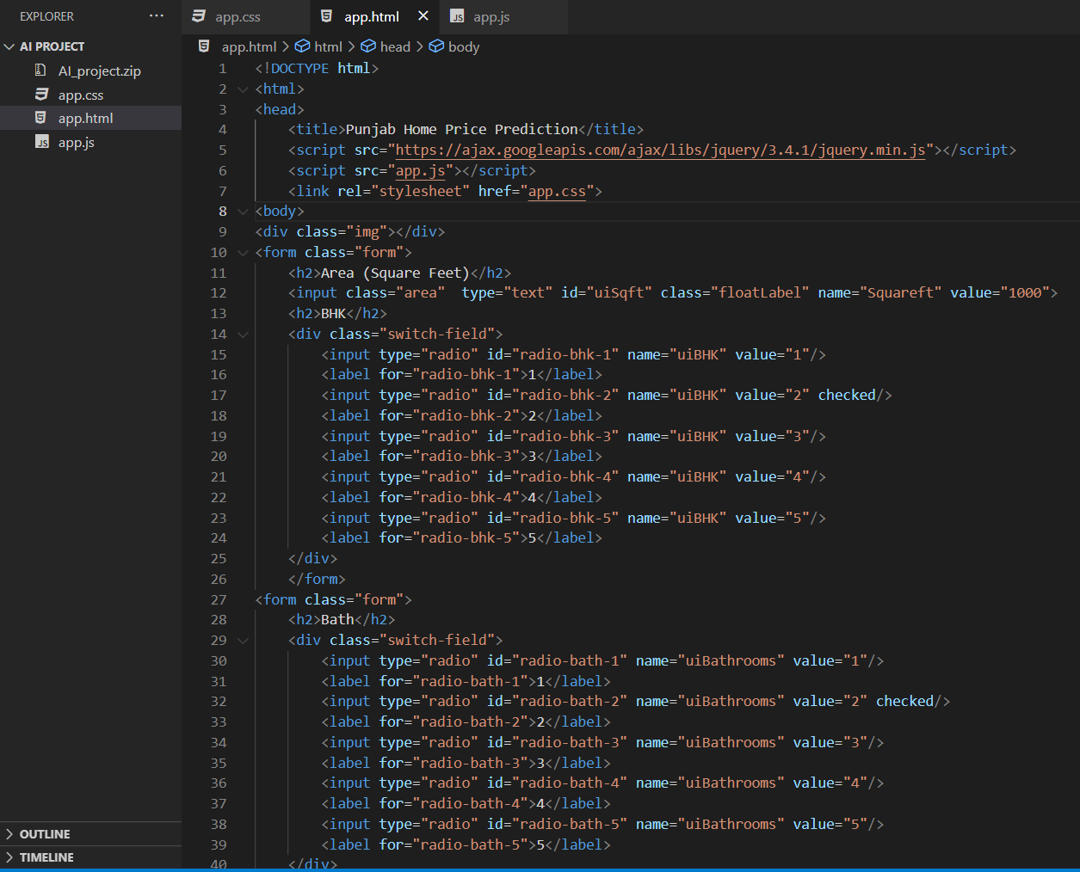
Screenshots of code

Slide 11
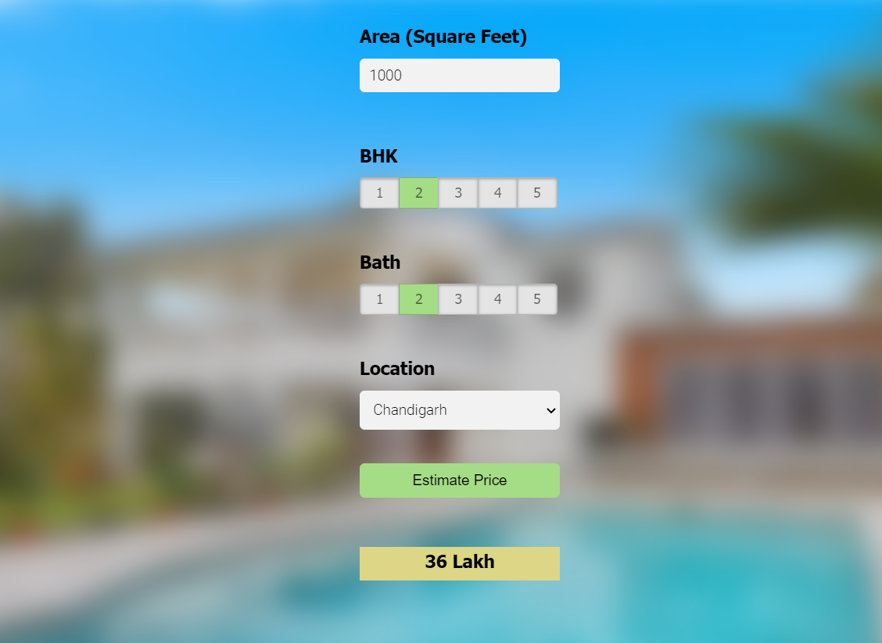
Output

Slide 12
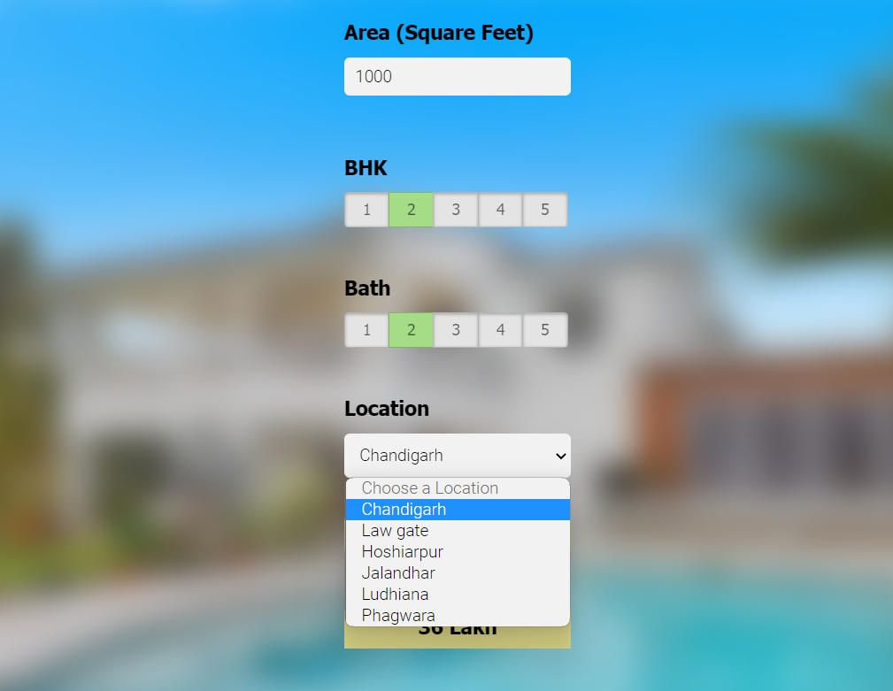

Slide 13

Thank you
Flora@contoso.com

